Slide 1
Facial emotion detection using svm, hog & cnn
AIE-B Group 2
Anantha Krishna SK (CB.SC.U4AIE24102)
Sri Ram Krishna M (CB.SC.U4AIE24127)
T Devi Sri Soumith (CB.SC.U4AIE24155)
Yogesh JK (CB.SC.U4AIE24161)

Slide 2
objectives
To classify the facial emotion into 7 categories.
Robust feature extraction using HOG,
Deep feature extraction using CNN.
Classification using SVM.
Real time detection.

Slide 3
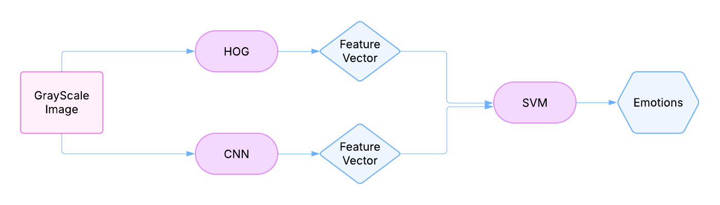
Methodology(Workflow)

Slide 4


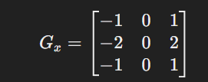
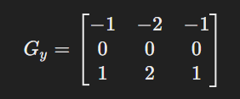
1.Histogram of oriented gradients
Grayscale image given as input
It calculates the gradients of the pixel intensity in x and y direction, and also the magnitude and direction of the gradient
The Gx and Gy are called “sobel” filters.
x [image] x [image]

Slide 5
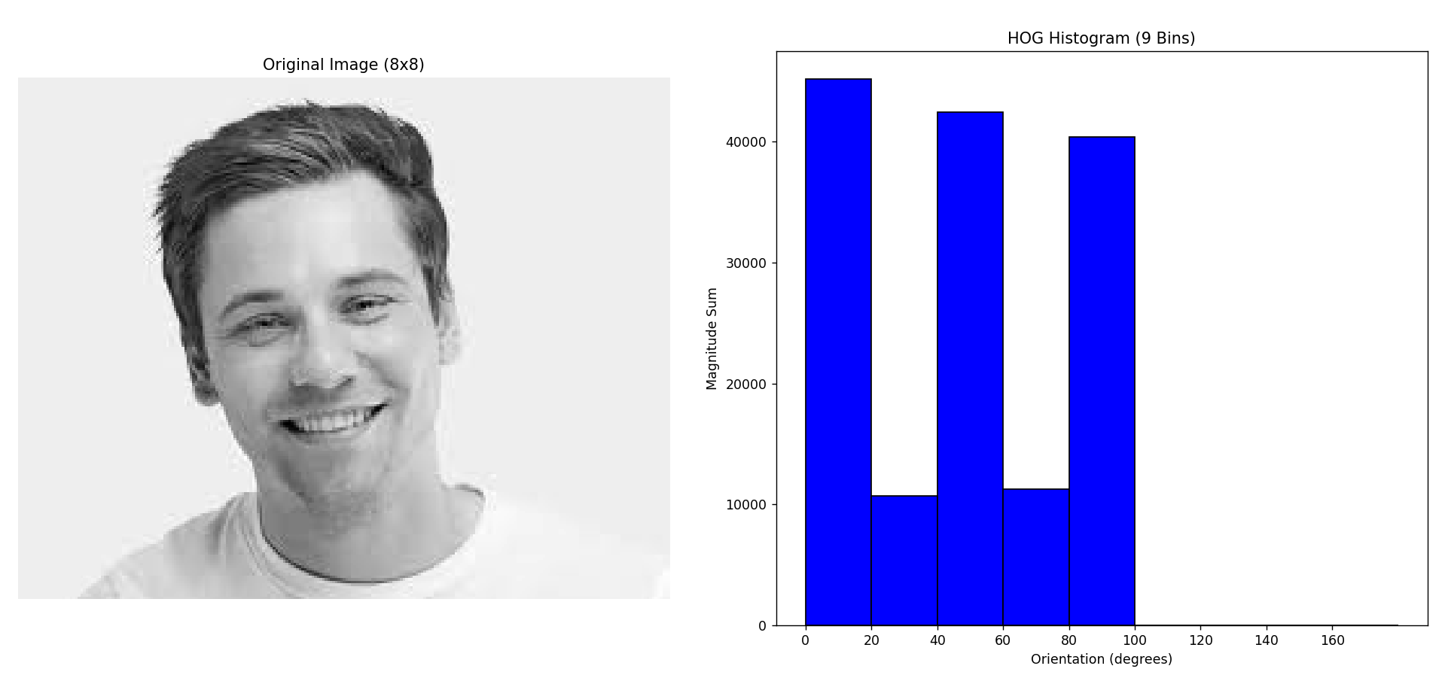
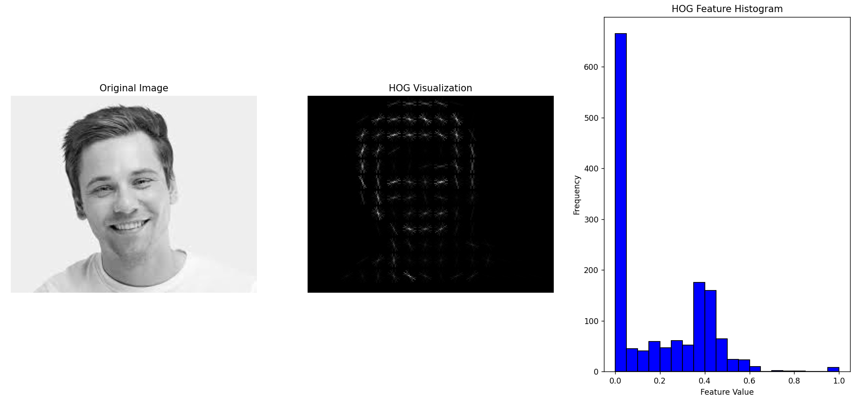
HOG Output

Slide 6
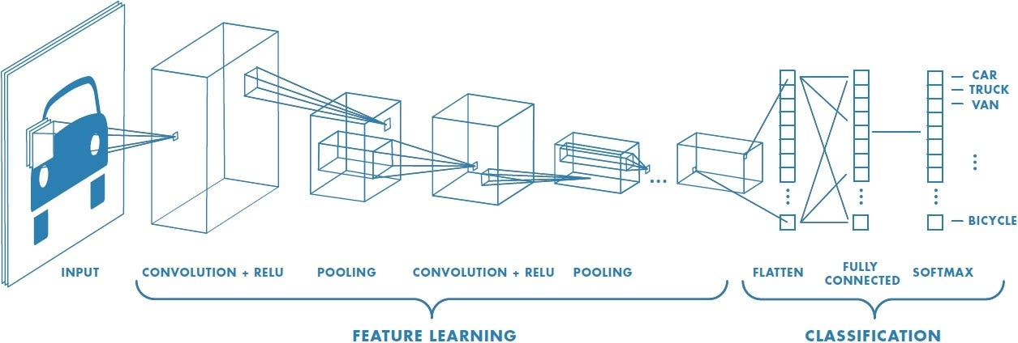
2.CNN
CNN processes images into multiple layers to extract features.
Feature extraction is done using kernels

Slide 7


I. Convolution operation:
Where, Y: output pixel value, I: input image pixel, K: kernel values, m,n: kernel size indices
Applies a filter(Kernel) to extract features.
II. ReLU activation:
Introduces non-linearity, removes negative values.

Slide 8

III. Max Pooling:
Where, Y: output, X: input feature map values, p,q: Indices inside the pooling window
Reduces spacial size and retains important features.
IV. Flattening (Converting to 1D Vector):
The pooled feature maps (which are still in a 2D format) are flattened to 1D layer
For ex: [[A1, A2, A3, A4], is converted to [A1, A2, A3, A4, B1, B2, B3, B4, C1, C2, C3, C4, D1, D2, D3, D4]
[B1 , B2, B3, B4 ],
[C1, C2, C3, C4],
[D1, D2, D3, D4]]

Slide 9
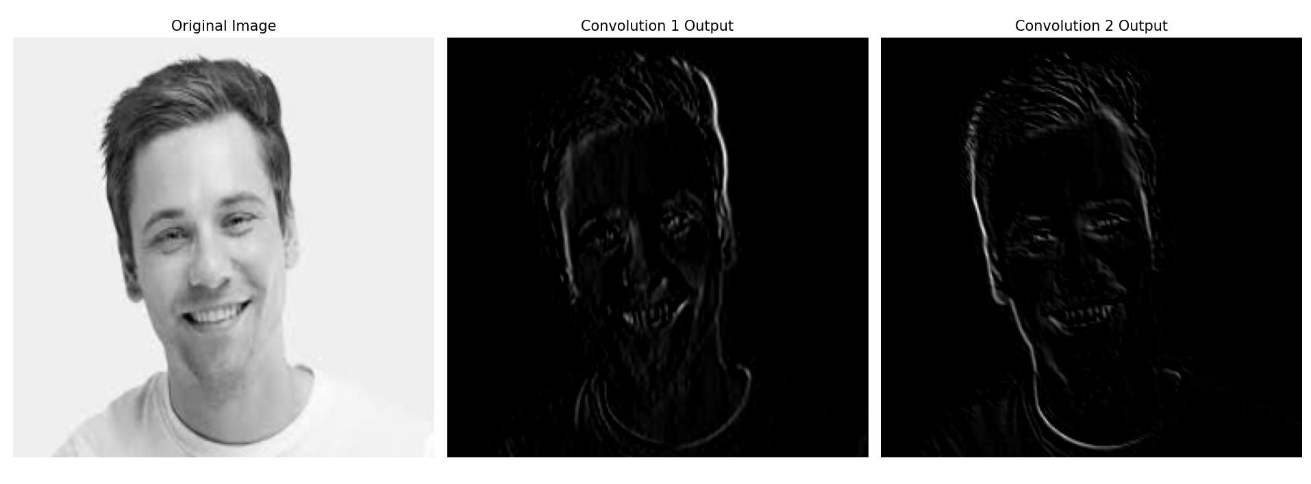
CNN Output

Slide 10



3.SVM
HOG captures gradient based features.
CNN captures deep hierarchical features.
Both CNN and HOG’s features are combined are given as input to SVM.
SVM finds an optimal hyperplane to separate different classes with the maximum margin.
HOG Feature CNN Feature Feature concatenation

Slide 11


I. SVM Hyperplane Equation:
w = Weight vector learned by SVM
F = Combined HOG + CNN feature vector
b = bias
II. RBF Kernel:
Where, K: kernel matrix, gamma: controls the spread of the kernel, x1,x2: two data points.
This matrix stores the similarity between all training points.

Slide 12
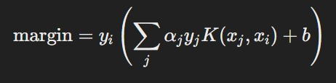


III. Margin:
Where, yi: class label of the data point xi, summation term: weighted kernel sum, b: bias value
Alpha values are Lagrange multipliers which determine the importance of each data point.
If margin >= 1: point is correctly classified, outside the margin
If margin <= 1: point is misclassified or inside the margin.
correctly classified misclassified
Where, η: learning rate, λ: regulisation parameter

Slide 13
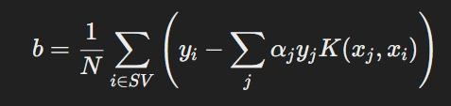
V. Bias Term:
Where, N: number of support vectors, yi: class label, summation term: weighted kernel sum.
This term ensures that the the decision boundary is correctly positioned in the feature space.
VI. SVM 1v1 (One-vs-One) Classification is a technique used to extend Support Vector Machines (SVMs) to handle multi-class classification problems
For k classes in the dataset, k(k-1)/2 binary classifiers are created.
Each classifier is trained to distinguish between two classes.

Slide 14
CONCLUSION
Work to be done:
Improving HOG to detect the edge pixels in a smooth manner.
Hyperparameter tuning for SVM.
HOG is to be Block normalized and Bilinear interpolation.
CNN extracts deep features with 2 layers and trained with SVM using rbf kernel and OvO method.
This is to be trained and saved

